Slide 1

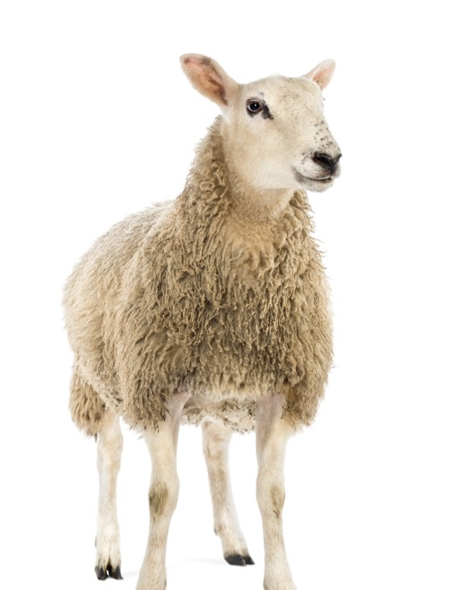
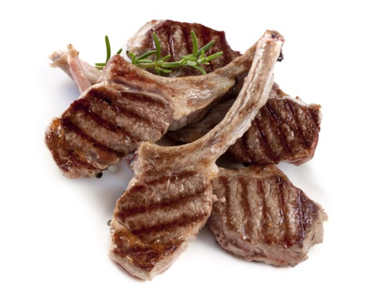
Exploring Opportunities
in the Agri-food Sector
Ashley Honsberger,
Executive Director
May 28 & 29, 2018
Little Currant

Slide 2
Agenda
About The Agri-Food Management Institute
Good news! Agriculture and Processing are Thriving in the Province
Opportunities in the Agri-food Sector and Your Community
Resources and Programs for the Ag Sector
Activity: let’s build a value chain!

Slide 3
About me…
With AMI for 7 years
City and country living
Volunteer work with dogs
This year I saw a Snowy Owl!

Slide 4
About the Agri-food Management Institute
Dedicated to promoting new ways of thinking about agri-food business management for farmers and agri-food processors.
Connecting farmers and food processors to business management tools, information, resources, and training.
Funded through the Canadian
Agricultural Partnership
www.TakeANewApproach.ca

Slide 5
Helping Farmers and Processors improve their skills in:
  Strategy, Planning, Communications
  Marketing, Supply Chain
  Financial Management, Benchmarking
  Human Resource Management
  Risk Management, Contingency Planning
  Training, Education, Use of Farm Advisors

Slide 6
Research we’ve done:
Baseline Study on Farmer Engagement with business planning
Baseline Study on processor Engagement with business planning
Dollars and Sense: Measuring the tangible impacts of farm business planning
Options for Mentorship and Internships for Agri-food in Northern Ontario (OMAFRA)
New stuff this year!
  Identifying Regional Opportunities for Farmers
  Supply Chain Gaps for Processors in Local Food

Slide 7



Based on research and industry knowledge we develop tools,
workshops and resources that help farmers and food & beverage processors…
Understand the business planning process
Get started on analysing their business
Plan out how to get a successsion plan underway
Think strategically and plan for success

Slide 8
Think Pair Share…
What agricultural or food processing activities are currently taking place in your community?
What potential benefits do you see coming from agriculture or food processing for the community?

Slide 9
Key takeaways
Consider what the goals of your community are in the context of an agri-food opportunity
Understand how food moves from farm to plate
Assess what may or may not be a good fit from a business perspective
Become familiar with resources that can connect your community to agriculture and food.

Slide 10
Demographics for Ontario Farm and Food industries

Slide 11
Farm and Total Population, Canada
Growing Population
But shrinking farm population

Slide 12
Number of Census Farms and Farm Area, Ontario,
1991 - 2016
Number of farms and farm area are decreasing
Worldwide trend of urban consumption of agricultural land
Source: Statistics Canada, 2016 Census of Agriculture; CANSIM 004-0002 CANSIM 004-0200

Slide 13
Share of Sales by Farm Size
16% of farms = 75% of sales

Slide 14
Number of Ontario Farms by Industry 2016
Very Diverse
Field crops
Dairy
Vegetables
Beef
Poultry
Swine
Eggs
Fruit
Potatoes
Dry beans
Sheep
Goats
Significant increase in Oilseed and Grain farms in 2016 compared to 2001
Decrease in Dairy Cattle and Milk Production farming, Beef cattle ranching and farming, Hog
and pig farming in 2016 compared to 2001
Source: Statistics Canada, Census of Agriculture; CANSIM 004-0014 CANSIM 004-200

Slide 15
Ontario’s agricultural lands are capable of producing a greater diversity of crops than most other parts of Canada. There are over 200 different commodities in total, including tender fruit and vegetable crops, grains and oilseeds.

Slide 16
Number of Livestock and Poultry on Farms
(in millions), Ontario, 1991 - 2016
(Beef is decreasing, hens and chickens are increasing)
Number of livestock and poultry on farm increasing
Source: Statistics Canada, Census of Agriculture; CANSIM CANSIM 004-0004 004-0223 CANSIM 003-0100

Slide 17
Major Horticultural Crop Area (acres), Ontario,
1991 – 2016
Since 2011, vegetable area slightly increased while potato and fruit areas slightly decreased.
Source: Statistics Canada, Census of Agriculture; CANSIM 0040003 CANSIM 0215 ; CANSIM 004-0214

Slide 18
Greenhouse area (‘000 sq ft), Ontario, 1991-2016
Significant increase in greenhouse area in 2016 compared to 1991
Source: Statistics Canada, Census of Agriculture; OMAFRA WEBSITE CANSIM 004-0217

Slide 19
Organic Farms, Ontario 2001-2016
Certified organic farms represent 1.3% of all farms in the province (2016) up from 0.6% in 2001
Source: Statistics Canada, Census of Agriculture; CANSIM 004-0211
Notes:
More organic operations
The number of certified organic farms continued to grow
Field crops and hay remained the largest certified organic product category
Most certified organic farms were in the $50,000 to $99,999 and $100,000 to $249,999 gross farm receipts classes.

Slide 20
Ontario Agriculture Summary
Fewer, larger farms
  But still many small-medium
  Not as consolidated as some other areas of Canada & US
Small to Medium farms are looking for opportunities to differentiate
  Specialty products
  Local food opportunities
  Selling directly to end users
  Working collectively to gain efficiencies

Slide 21
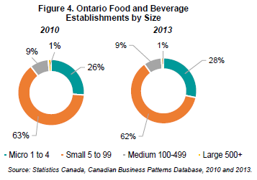
~3,000 Food and Beverage Processors
Many Small and Medium

Slide 22
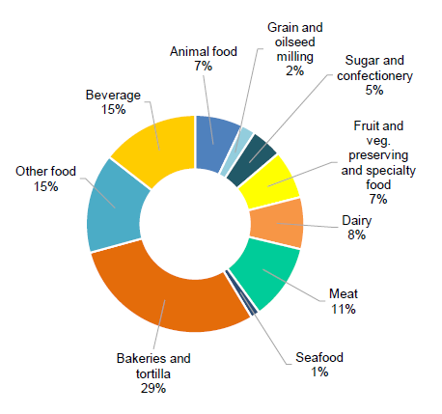
Food Processing By Subsector
Also very diverse:
Meat = 28%
Dairy = 8%
Beverage
Bakery
Grain Milling
Other
Fruit and Veg
Number of Establishments by Subsector, 2012

Slide 23
Group Question:
Does your region or community have an agri-food sector study?
Have you used it and if so, for what?

Slide 24
Opportunities in the Agri-food Sector and Your Community

Slide 25
Developing an Agri-food Business
Who will buy it?
Do they want it?
Can you grow or make it?
How will it get there?
Can you make it financially viable?
Consumer Profile
Assess the Market
Production Capabilities
Distribution and Logistics
Business Case

Slide 26
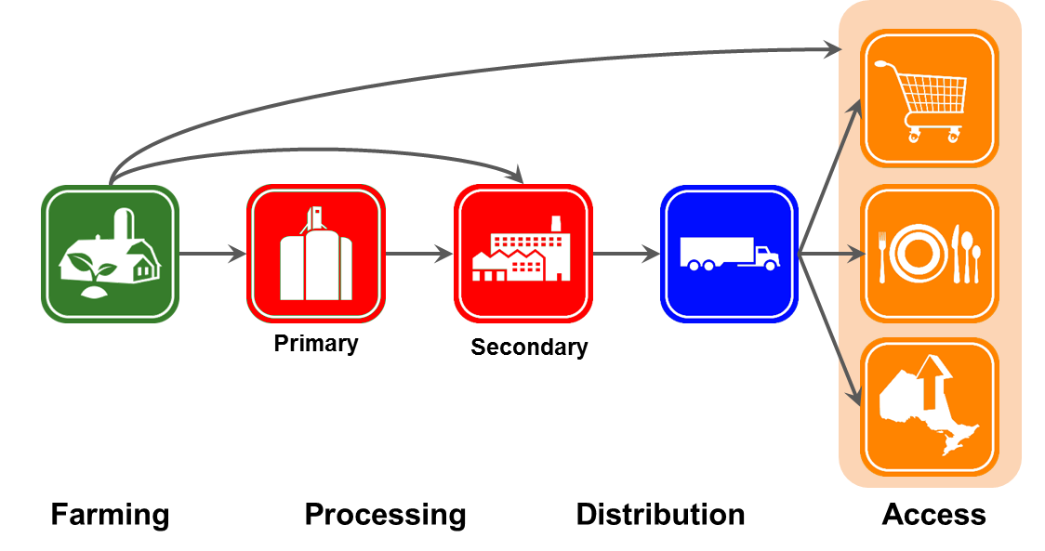
Agri-food Value Chain Segments
Ontario has the 2nd largest food and beverage manufacturing sector in NA
Ontario-based food processors buying about 65% of farm production
Notes:
There are close to 3,000 food and beverage processing businesses in the province.
In 2012, food and beverage processors comprised the second largest manufacturing sector in terms of value of shipments and employment in Ontario.
Ontario has the 2nd largest food and beverage manufacturing sector in North America.
Food and beverage processing is the first customer to farmers, with Ontario-based food processors buying about 65% of food-related farm production from farmers.

Slide 27
Markets
Local – who’s in your backyard?
Regional – what’s the access level?
Larger areas: Greater Toronto Area, Ontario
Notes:
How to make connections
Food miles create logistical challenge
Backyard has direct customer linkage and easier marketing

Slide 28
Markets
Local – who’s in your backyard?
Larger areas: Greater Toronto Area, Ontario
Regional – what’s the access level?
Community gardens
Serving the local coop
Restaurant or cafeteria
Saturday farmers market
Notes:
How to make connections
Food miles create logistical challenge
Backyard has direct customer linkage and easier marketing

Slide 29


Local – who’s in your backyard?
Regional – what’s the access level?
Larger areas: Greater Toronto Area, Ontario
Markets
http://tbfoodstrategy.com/
http://www.actualitealimentaire.com/wp-content/uploads/2013/08/14-021_localfood_cfic_rpt.pdf
Notes:
How to make connections
Food miles create logistical challenge
Backyard has direct customer linkage and easier marketing

Slide 30
Markets
Local – who’s in your backyard?
Regional – what’s the access level?
Larger areas: Southern Ontario
Socio-demographics of underserved groups
  Organic
  Vegetarian or soy based
Gourmet and artisan
  Handmade
  Loca-vore & “Terroir”
  Value added (chopped and ready to cook)
Ethnicity related markets
  Goat meat for Caribbean market
  Lentils
Halal and Kosher
  Lamb during Eid
“Free from”
  Allergies
  Gluten
Preference
  Clean labelling
  “Healthy” claims (ie. Anti-oxidants
What are current food trends?
Notes:
How to make connections
Food miles create logistical challenge
Backyard has direct customer linkage and easier marketing

Slide 31
Finding and Assessing the Market
You can find out if there is a market for your product by:
  Understanding the revenues for the market
  Knowing how many competitors there are
  Determining if the market is growing or shrinking
You can further assess this market by finding out:
  What has made the existing firms in this market successful
  Are there different segments to the market, or is there a niche?
  What group of consumers could be targeted first?

Slide 32
Production Capacity
Can you grow it or make it?
Can you grow or make enough?
Will it make money?
What assets are available?
What grants or investments are available?

Slide 33
Don’t let distribution get you down!
There are a number of models that have been developed in Ontario
Northern School Fruit and Vegetable Snack Program

Slide 34
Finding agri-food leaders
Farmer interest
Are local farmers interested?
    Who? How many?
    What are they really good at producing?
    Are there opportunities for new farmer training?
    What traditional knowledge can be shared?
Processor interest
  Who is making food products locally?
  Can they mentor others and share knowledge?
  Where can they go for more information?
Food safety
  Do your farmer suppliers have food safety programs in place?
    If not, can you provide training and support to get there?

Slide 35
Foundation for Building a Business Case
The purpose of a business case is to communicate to project partners…
1. Cost Benefit Analysis
2. Planning the budget
3. Identifying project alternatives
4. Risk Management Plan
5. Selecting the right strategy

Slide 36
Costs and Benefits need to be: SMART!
Specific
Measurable
Achievable
Realistic
Time bound

Slide 37
Cost Benefit Analysis

Slide 38
1. Cost benefit analysis
Initial Costs | Examples | Benefits | Examples
Purchase | Actual cost shipping | Reduced expenses | Calculate the hours it saves, hourly rate of the person doing that task Less gas used
Installment | Ie. Processing equipment Training | Increased revenue | Improved quality Improved volume $ earned
Operation | Gas/oil changes Time | Increased markets | More variety (ie small potatoes and large potatoes)
maintenance | Replacement parts Maintenance person How long will the equipment last? Storage | Risk reduction | Ie. Old equipment is dangerous to users Environmental impact
Total Costs | ? | Total Benefits | ?

Slide 39
2. Outline your budget clearly…
Equipment Cost Year 1
Initial cost
Installation
Operation
Maintenance
New parts
Storage

Slide 40
3. Investment alternatives: some questions to answer...
Who can access
the resource?
Why this resource?
Are there alternatives?
What will happen if this grant isn’t received?
Why now?

Slide 41
4. Risk Mitigation Plan
Things that might happen | What we will to do avoid that happening
Eg. A new driver uses the equipment and hurts themselves while plowing the field | Everyone who uses the tractor must have 2 days of training and be supervised while using it
Eg. The resource doesn’t get shared fairly | A procedure with a time chart will be posted so people can sign up to rent the commercial kitchen space. Policies will be developed when the kitchen space opens up.
Eg. The equipment breaks and the maintenance person lives 10 hours away | We will find 2 or 3 people who know how to fix the equipment and set up a system that we can have access to their expertise (in person or via webinar)

Slide 42
5. Selecting the right strategy
Outlining the opportunity, summarizing the benefits, telling your story!

Slide 43

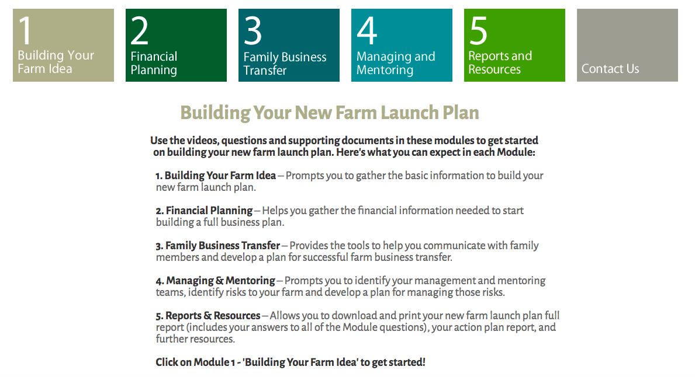

Slide 44
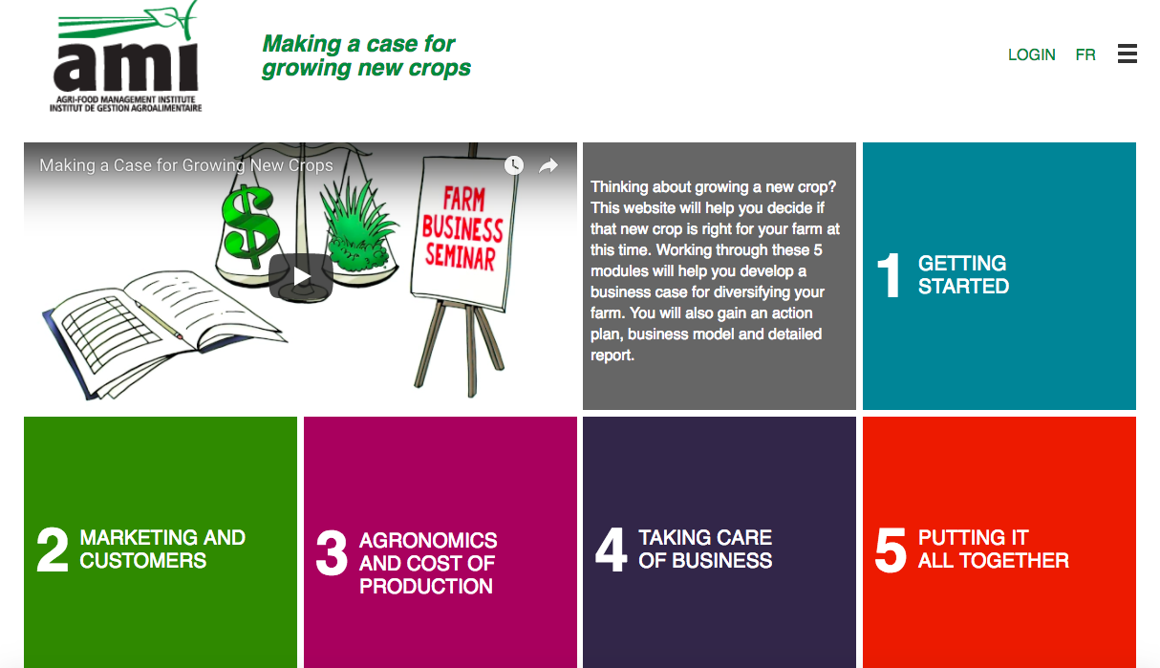

Slide 45
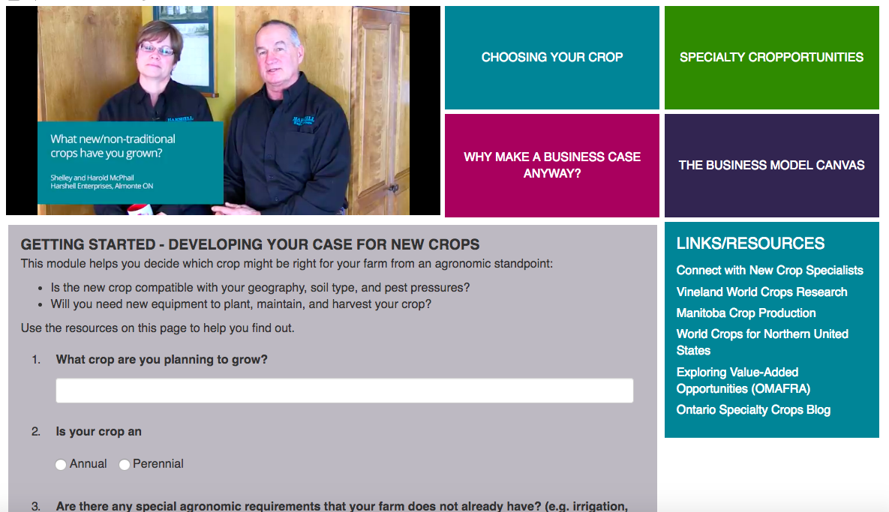

Slide 46
Resources and Programs for the
Agri-food Sector

Slide 47
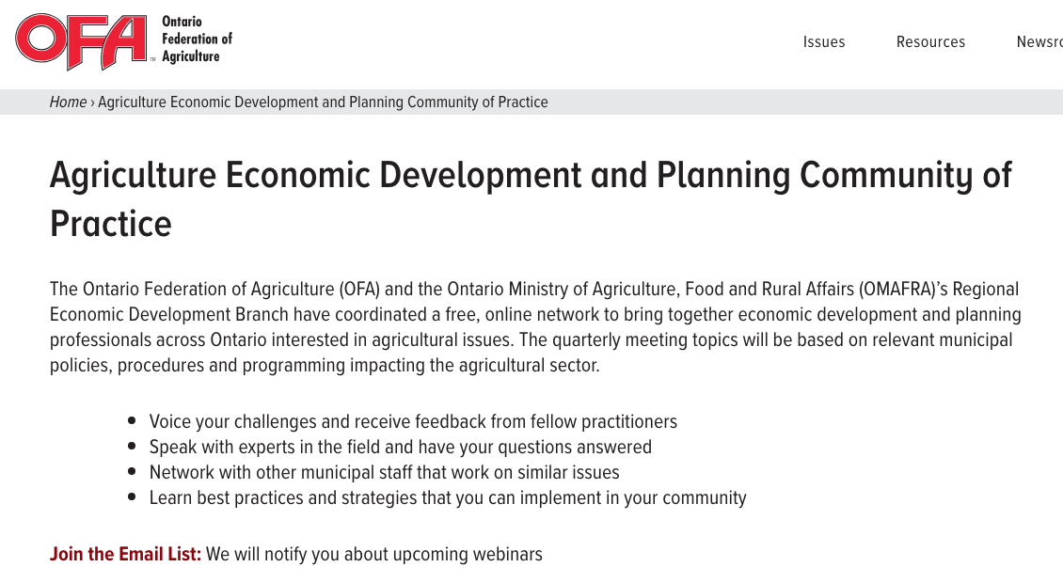
Some programs or resources that might be of interest…
ofa.on.ca/CommunityofPractice/

Slide 49
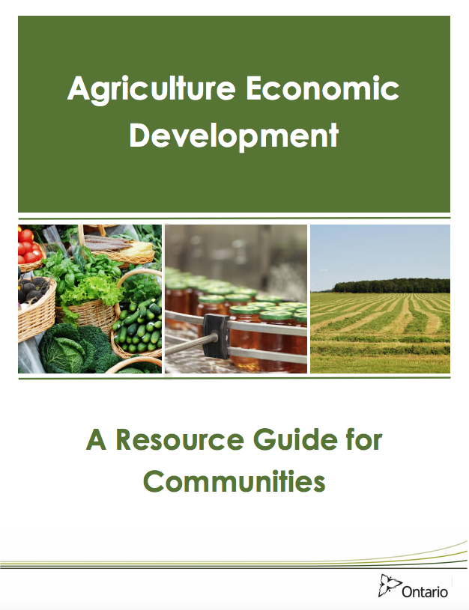
Hot off the press!
Link to resource:
http://www.omafra.gov.on.ca/english/landuse/aed.pdf

Slide 50

Value added products
Resources:
https://www.slideshare.net/tedore/value-added-products-steps-to-success
https://ontarionature.org/wp-content/uploads/2017/10/beyond_the_fields.pdf

Slide 51
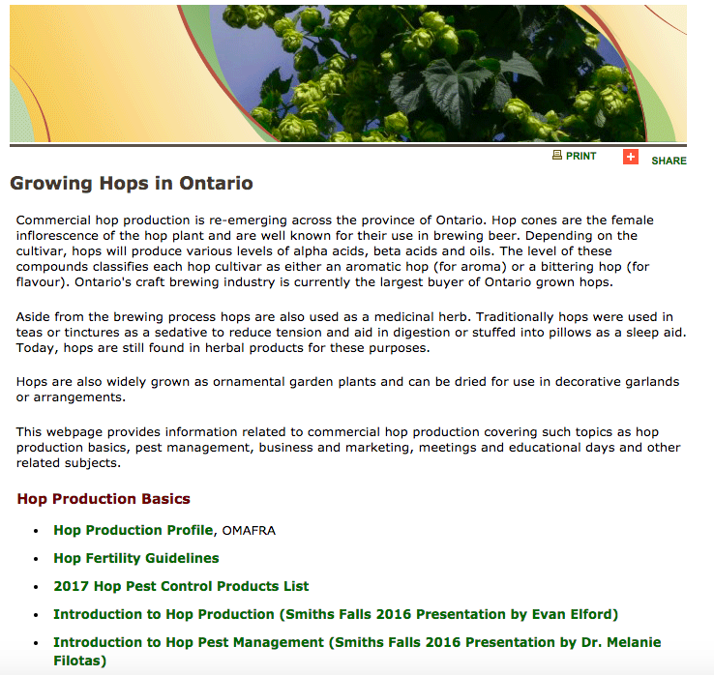
Hops!
http://www.omafra.gov.on.ca/english/crops/hort/hops.html

Slide 53
Freshwater Fish
Smoked Trout
Thunder Bay Processing Plant

Slide 54
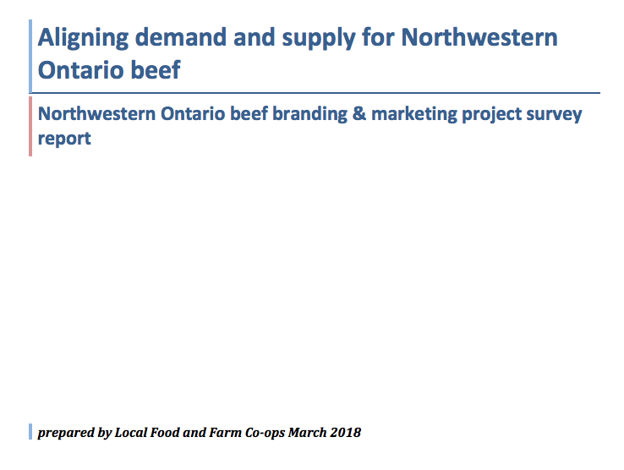
“Beef North”

Slide 55
Artisanal Chicken program
The Artisanal Chicken Program is directed at those farmers who are interested in growing between 600 and 3,000 chickens annually for select target markets such as local farmer markets.
Carl Stevenson (Hullett Township)
Carl.Stevenson@ontariochicken.ca
289-288-4217

Slide 56
Food incubators and commercial kitchens
Coburg, Ontario

Slide 57
Food incubators and commercial kitchens
Toronto, Ontario
Recipe testing
Scaling up ideas
Access to experts
Try out equipment
Etc.

Slide 58
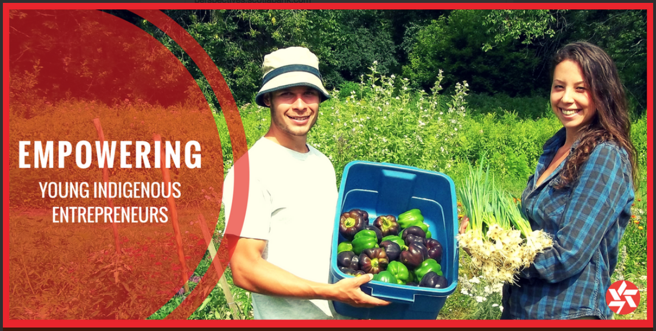
Summary
Assess potential opportunities thoroughly
Utilize the existing resources for success!
Ensure the people involved are equipped to be successful

Slide 59
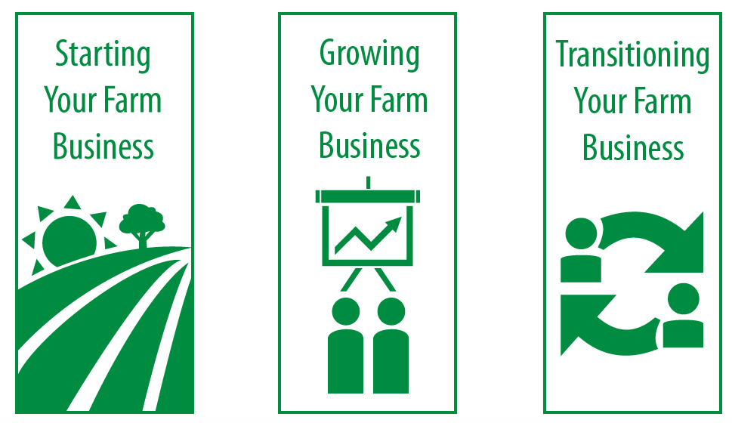
AMI Is here to Help!
New entrants to farming support
Existing farmer training
Processor business management and development resources

Slide 60




Stay informed by joining our newsletter!
www.TakeANewApproach.ca
@AMIOntario
AMIOntario
Agri-food Management Institute
Ph: 519-822-6618
ashley@TakeANewApproach.ca
Notes:
Follow us on Twitter, Facebook, and LinkedIn for additional updates, or contact us to learn more about specific resources, tools, or courses available.

